Slide 1
Name: Patel Shivam S.
Enroll no: 21162101019
Branch: CBA
Sem: 3

Slide 2
Employee Seating Assessment
Project :

Slide 3
Objective :
→ The main objective of the Employee Seating Assessment is to manage the details of Employee, Seats, Customers and Work.
→ The project is totally built at administrative/Head Officer end and thus only the administrator/Head Officer is guaranteed the access. Thus , it makes the arrangement organised and centralised.
→ The purpose of the project is to build an application program to reduce the manual work for managing the Seats, Customer.
→ To track all the details about the Customers , Employees.
.

Slide 4
Introduction :
→ The “ Employee Seating Assessment” has been developed to override the problems prevailing in practicing manual system. This software is supported to eliminate and reduce hardships faced by existing system.
→ This project provides a way to allocate Seats for each employee of various branches and sections without any clash . It also keep a check at the duties of various employee at different seats during work.
→ The system stores list of employees , customers and list of employees appearing on each day.
→ The purpose of the project is to build an application program to reduce the manual work for managing the Seats, Customer.
→ To track all the details about the Customers , Employees.
.

Slide 5
REQUIREMENTS :
04
Hardware :
Software :
→ Laptop
→ IntelliJ IDEA CE
→ Frontend Programming
→ Backend Programming
→ Database Connectivity
01
03
MySQL
For Creating Database Applying Queries
02

Slide 6
Existing System:
In the existing system the attendance is done only manually but in proposed system we have to computerize the attendance using this application.
→ More man power
→ Time Consuming
→ Consumes large volume of paper work.
→ Needs Manual Calculation.
01

Slide 7
Proposed System:
The aim of the proposed system is to develop a system of improved facilities.The proposed system can improve all the limitation of the existing system.The system provides proper security and reduces manual work.
→ Security of data.
→ Proper control of head officer.
→ Minimize manual data entry.
→ Greater efficiency.
→ User friendly and interactive
02

Slide 8
Explanation :
→ The user in the management system is the administrator/officer that does the authentication by logging in with the respective credentials.
The user has two ways to access the management system → Customer management → Employee management
The purpose of the project is to build an application program to reduce the manual work for managing the Seats, Customer.
→ To track all the details about the Customers , Employees.
.

Slide 9
Employee Management Section :
→ It consists of details of employee such as name , ID and department, seat no.
→ The allotment of every employees is done to each desk/chair where chair is empty.
→ The allotment is done using the Random Function.
→ This process goes on unless every chair is given employees to perform their respective duty.
The user has two ways to access the management system → Customer management → Employee management
The purpose of the project is to build an application program to reduce the manual work for managing the Seats, Customer.
→ To track all the details about the Customers , Employees.
.

Slide 10
Customer Management Section :
→ It consists of details of customer such as name , phone number.
→ Whenever customer enter the system they have to give answer about employee is there available or not. So system can do attendance of employee.
→ If employee is not their then system tell them to go another employee who is present nearby him.
→ And employee solve the problem of customer then system will ask to give feedback out of 10. So that Officer will know how their employee works good or not!!
The user has two ways to access the management system → Customer management → Employee management
The purpose of the project is to build an application program to reduce the manual work for managing the Seats, Customer.
→ To track all the details about the Customers , Employees.
.

Slide 11
Packages used :
Java.Lang : Provides classes that are fundamental to the design of the Java programming language. The most important classes are Object, which is the root of the class hierarchy, and Class, instances of which represent classes at run time and it is a default package in java.
Java.util: It contains the collections of framework,legacy collection classes, event model, date and time facilities, internationalization, and miscellaneous utility classes .

Slide 12
Packages used :
Java.sql : We have relational databases, from which at many times we need to access the data. For various data processing related matters from RDBMS we have java.sql package.

Slide 13
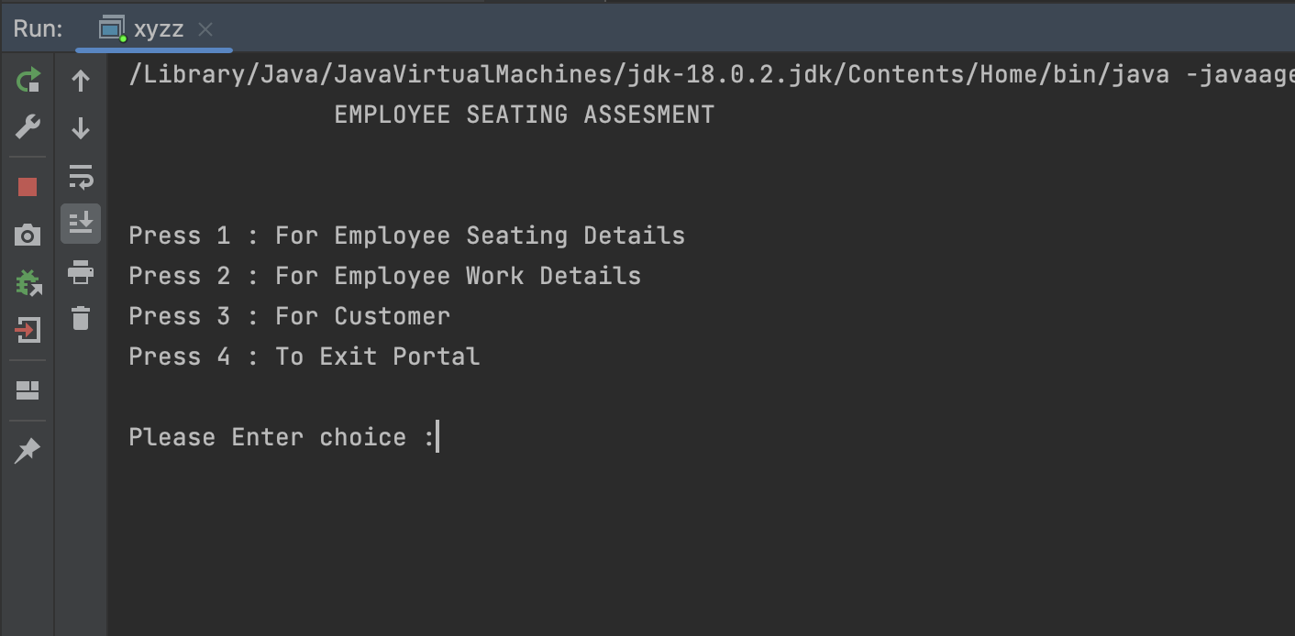

Slide 14
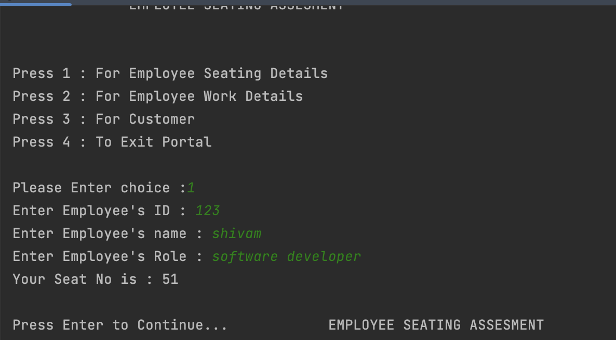

Slide 15
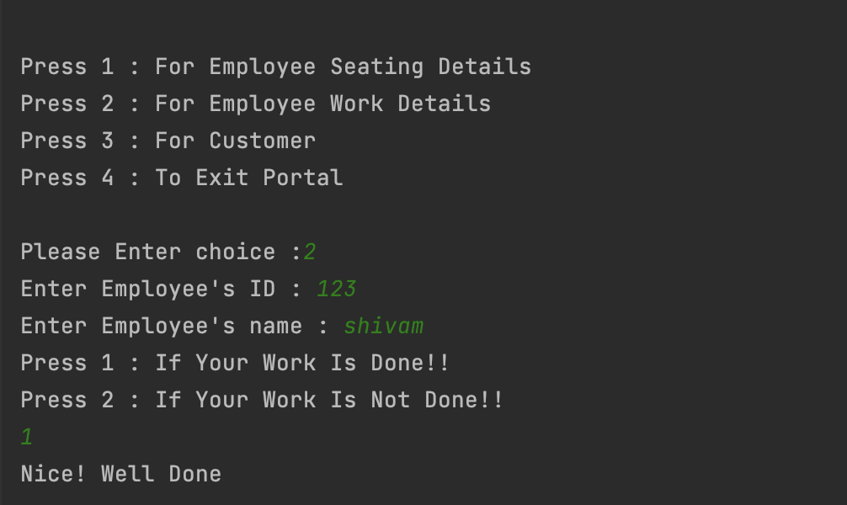

Slide 16
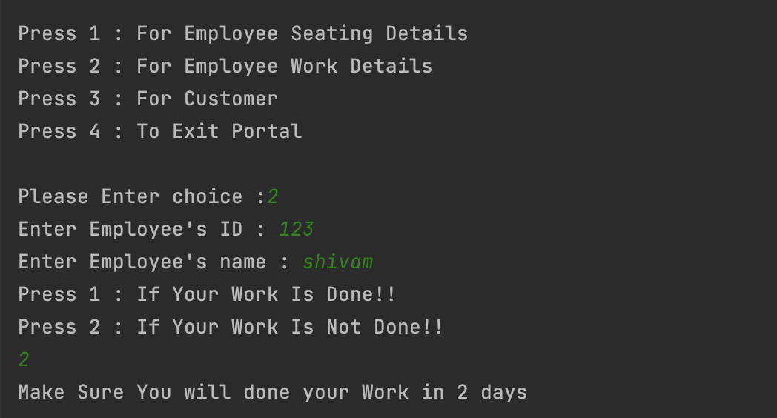

Slide 17
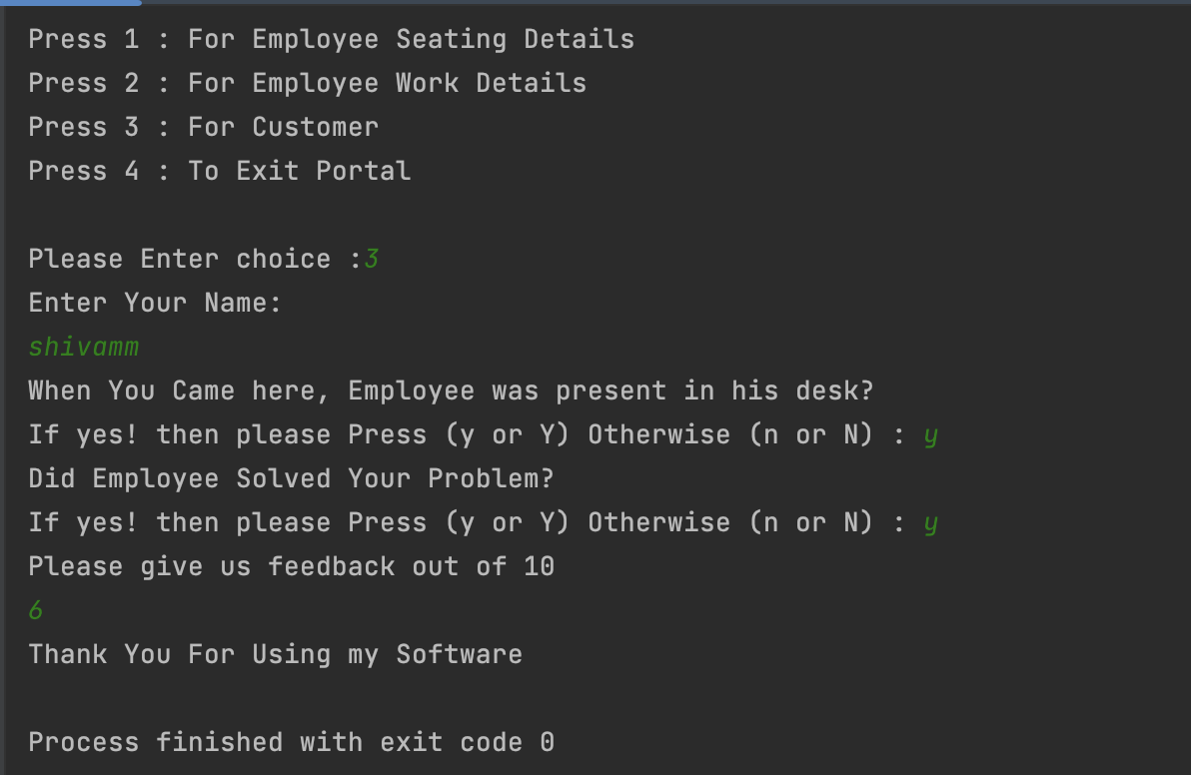

Slide 18
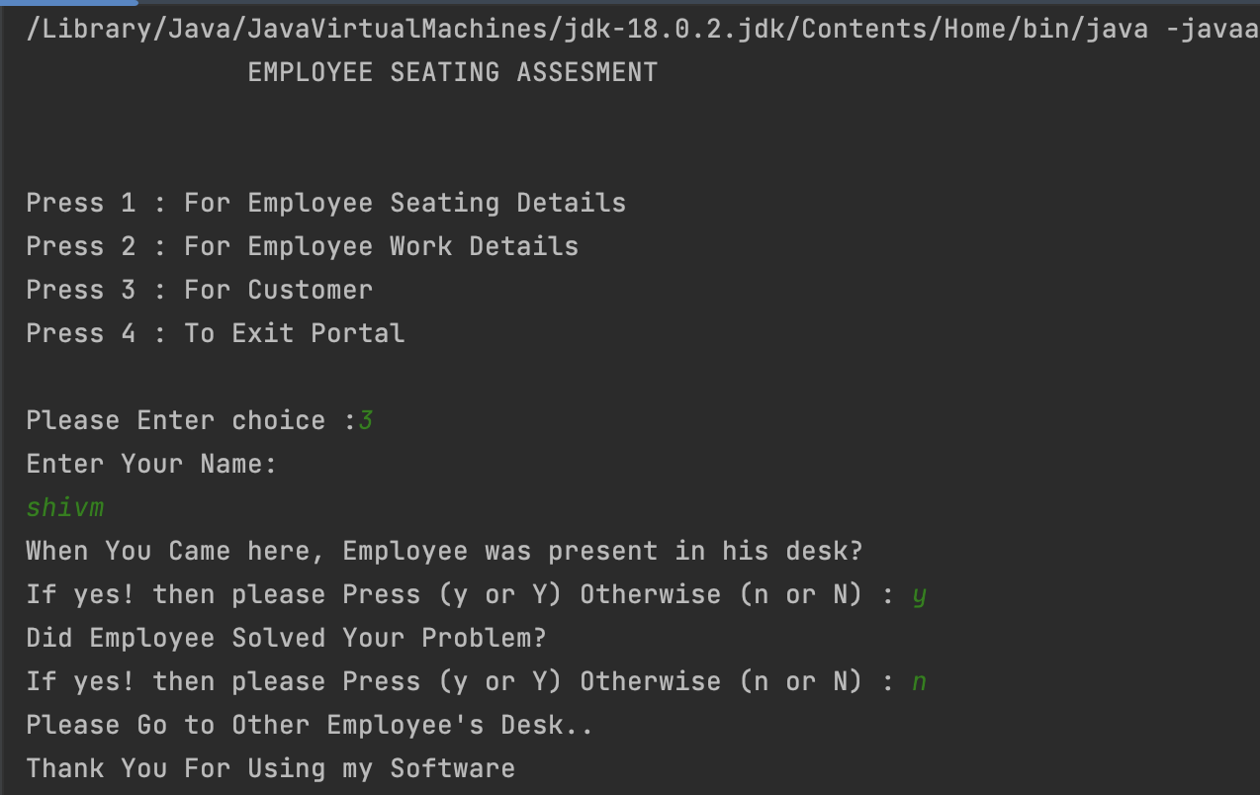

Slide 19
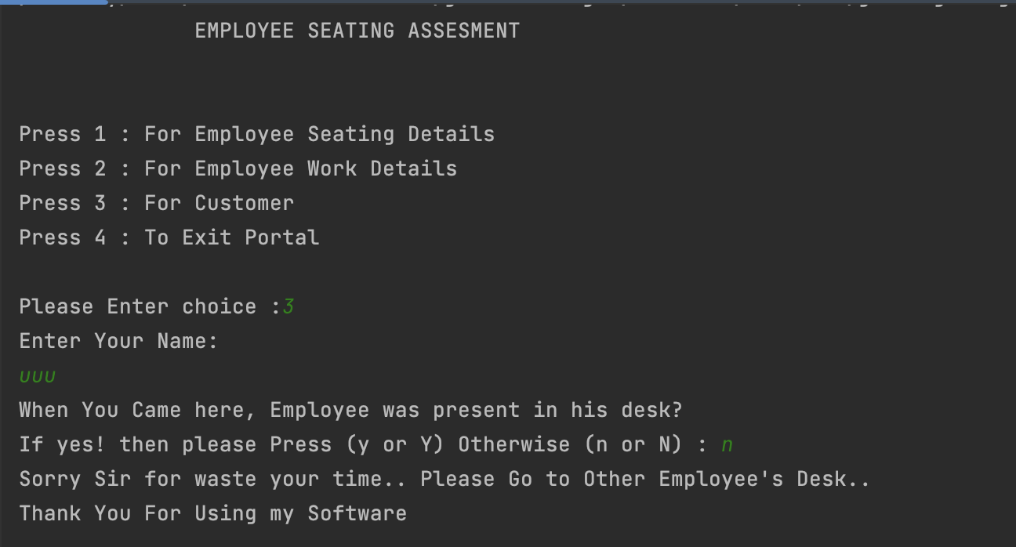

Slide 20
Conclusion:
--->Hence, a system will be developed which will help in managing all the procedures. It helps in avoiding the manual work and all the problems with it. The following conclusions can be drawn from the project:-
→ automation of the entire system provides efficiency.
→ Inserting of information becomes easier.
→ It gives appropriate to the authorised user.
→ It effectively overcomes the delay in communication.

Slide 21
References:
→ Stackoverflow.com
→ Javatpoint.com
→ Geeksforgeeks.com

Slide 22

Thank you!

